Slide 1
Topic 18(c):
Communicating Information
18.1 Principles of Modulation
18.2 Sidebands and bandwidth
18.3 Transmission of information by digital means
18.4 Different channels of communication
18.5 The mobile-phone network

Slide 2
ATTENUATION
Reduction of energy in transmission

Slide 3
Attenuation
When an electrical signal is transmitted along a metal wire, it gradually loses power, mostly as thermal energy in overcoming resistance of the wire and a small amount as electromagnetic radiation emitted by the current.
A light pulse travelling along an optic fibre loses power, mostly by absorption due to impurities in the glass and by scattering due to imperfections.
Electromagnetic waves lose power by absorption and dispersion through the medium.
A reduction in signal power is referred to as attenuation.

Slide 4
Amplification
In order that a signal may be detected adequately, its power must be a minimum number of times greater than the power associated with noise. Typically, this signal-to-noise ratio could be 100.
Repeater amplifiers may be required to increase the power of a signal that is being passed along a transmission line.
The gain of such an amplifier (the ratio of the output power to the input power) could be 100000 (10⁵).
For a radio link between Earth and a geostationary satellite, the power received by the satellite may be 10¹⁹ times smaller than that transmitted from Earth.

Slide 5
Comparison of Power
In comparing power levels, two numbers are involved and the ratio can be very large or very small.
An extremely convenient unit by which power levels, or any other quantities, may be compared is the bel (B).
The number of bels is related to the ratio of two powers P₁ and P₂ by the expression:
number of bels = lg(P₁/P₂)
As the bel is a large unit, the ratios are usually expressed in decibels (dB), where 10 dB = 1 B.
Consequently,
number of decibels = 10 lg(P₁/P₂).
If there is amplification, P₂ > P₁
If there is attenuation, P₂ < P₁

Slide 6
Example 1
The gain of an amplifier is 45 dB. Calculate the output power P_{out} of the amplifier for an input power P_{in} of 2.0 μW.
Solution:
number of decibels = 10 lg(P₂/P₁)
45= 10 lg(P_{out} / 2.0 × 10⁻⁶)
4.5 = lg(P_{out} / 2.0 × 10⁻⁶)
10^{4.5} = (P_{out} / 2.0 × 10⁻⁶)
P_{out} = 10^{4.5} × 2.0 × 10⁻⁶
P_{out} = 6.3 × 10⁻² W

Slide 7
Example 2
A signal having a power of 2.4 μW is amplified in a two-stage amplifier. The first stage has a gain of 18 dB and the second stage provides a further amplification of 25 dB. Calculate:
(a) The total gain of the two-stage amplifier
(b) The power of the output signal from the amplifier.
Solution:
(a) Total gain in dB = 18 + 25 = 43 dB
(b) Gain in dB = 10 lg (P_{out} / P_{in})
43 = 10 lg (P_{out} / 2.4 × 10⁻⁶)
4.3 = lg (P_{out} / 2.4 × 10⁻⁶)
10^{4.3} = P_{out} / 2.4 × 10⁻⁶
P_{out} = 2.4 × 10⁻⁶ × 10^{4.3}
P_{out} = 0.048 W

Slide 8
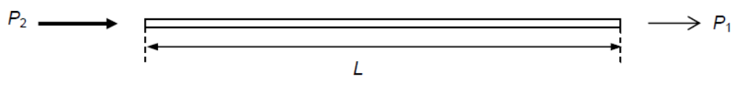

Attenuation per unit Length
A transmission line has an input power P₂ and the power at a point distance L along the line is P₁ as illustrated in the diagram.
Then, attenuation in the line = 10 lg (P₂ / P₁) dB.
Since a transmission line may vary in length, an important feature of a transmission line is its attenuation per unit length.

Slide 9
Example 3
The input power to a cable of length 25 km is 500 mW. The attenuation per unit length of the cable is 2 dB km⁻¹. Calculate the output power of the signal from the cable.
Solution:
signal loss in cable = 2 × 25 = 50 dB
50= 10 lg(500 × 10⁻³ / P_{out}),
where P_{out} is the output power.
P_{out} = 500 × 10⁻³ × 10⁻⁵ = 5 × 10⁻⁶ W.

Slide 10
Distance to Amplify
The signal cannot be allowed to travel indefinitely in the cable because, eventually, it will become so weak that it cannot be distinguished from background noise.
An important factor is the minimum signal-to-noise ratio that effectively provides a value for the lowest signal power allowed in the cable.
In the previous example, the background noise is 5 × 10⁻¹³ W and the minimum signal-to-noise ratio permissible is 20 dB. Then if P_{M} is the minimum signal power,
20 = 10 lg(P_{M} / 5 × 10^{–13})
P_{M} = 5 × 10^{–13} × 10² = 5 × 10^{–11} W.
This enables the maximum uninterrupted length of cable along which the signal can be transmitted to be determined.
Maximum loss in cable = 10 lg(500 × 10⁻³ / 5 × 10-¹¹) = 120 dB
Maximum distance = 120 / 2 = 60 km.

Slide 11
Example 4
The signal input to an optical fibre is 7.0 mW. The average noise power in the fibre is 5.5 × 10⁻¹⁹ W and the signal-to-noise ratio must not fall below 24 dB. The fibre has an attenuation of 1.8 dB km⁻¹. Calculate:
(a) The minimum effective signal power in the cable
(b) The maximum uninterrupted length of the optic fibre through which the signal can be transmitted.
Solution:
(a) Number of decibels = 10 lg(P₂ / P₁)
24 = 10 lg(P_{min} / 5.5 × 10⁻¹⁹)
2.4 = lg(P_{min} / 5.5 × 10⁻¹⁹)
10^{2.4} = P_{min} / 5.5 × 10⁻¹⁹
P_{min} = 10^{2.4} × 5.5 × 10⁻¹⁹
P_{min} = 10^{2.4} × 5.5 × 10⁻¹⁹
P_{min} = 1.38 × 10⁻¹⁶ W
(b) Attenuation = 10 lg (P_{in} / P_{out})
= 10 lg(7.0 × 10⁻³ / 1.38 × 10⁻¹⁶) = 137 dB
Therefore maximum uninterrupted length = 137 / 1.8 = 76 km

Slide 12
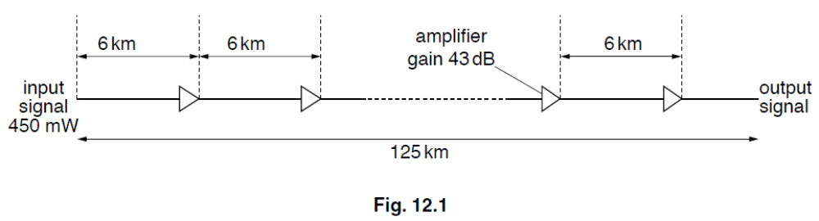
Attenuation: May 2009 Q12
A signal is to be transmitted along a cable system of total length 125 km.
The cable has an attenuation of 7 dB km–1. Amplifiers, each having a gain of 43 dB, are placed at 6 km intervals along the cable, as illustrated in Fig. 12.1.
(a) State what is meant by the attenuation of a signal.[1]
(b) Calculate
(i) the total attenuation caused by the transmission of the signal along the cable, [1]
(ii) the total signal gain as a result of amplification by all of the amplifiers along the cable. [1]
(c) The input signal has a power of 450 mW. Use your answers in (b) to calculate the output power of the signal as it leaves the cable system [3]

Slide 13
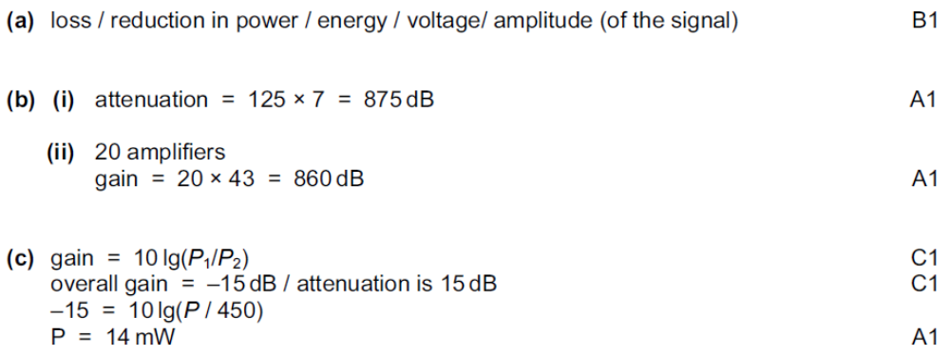
Solution: May 2009 Q12

Slide 14
Satellites

Slide 15
Why Communication Satellites
Long-distance communication using radio waves is possible on the MW waveband (as surface waves) and the SW waveband (as sky waves). However, there are major disadvantages:
Using sky waves is unreliable as it relies on ionospheric reflection. The layers of ions in the upper atmosphere vary in height and density giving rise to variable quality of signal.
Surface waves are also unreliable because there is poor reception in hilly areas.
The wavebands available on MW and SW are already crowded.
The available bandwidths are too narrow to carry the required amount of information.
Satellite communication enables more wavebands to be made available and at much higher frequencies, thus giving rise to as much greater data-carrying capacity.

Slide 16
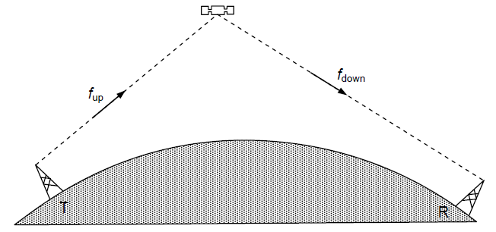
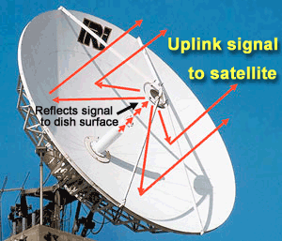
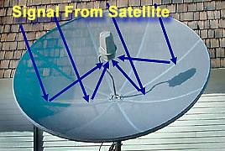
Principle of Satellite Communication
satellite
Earth’s surface
A carrier wave of frequency f_{up} is sent from a transmitter T on Earth to a satellite
The satellite receives the greatly attenuated signal.
The signal is amplified and the carrier frequency is changed to a lower value f_{down}.
The carrier wave is then directed back to a receiver R on Earth.
The carrier wave frequencies f_{up} and f_{down} are different so that the very low power signal received from Earth is not swamped by (can be distinquished from) the high power signal that is transmitted back to Earth
Values of the ‘uplink’ frequency f_{up} and the ‘downlink’ frequency f_{down} might be 6 GHz and 4 GHz respectively (the 6/4 GHz band). Other bands are 14/11 GHz and 30/20 GHz.

Slide 17
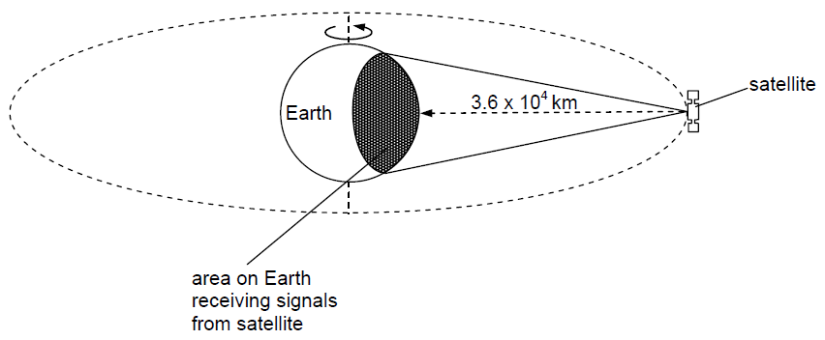
Geostationary Satellite
Geostationary satellites orbit the Earth above the Equator with a period of 24 hours at a distance of 3.6 × 10⁴ km above the Earth’s surface.
If the satellite is orbiting in the same direction as the direction of rotation of the Earth, then, for an observer on the Earth, the satellite will always appear to be above a fixed position on the Equator

Slide 18
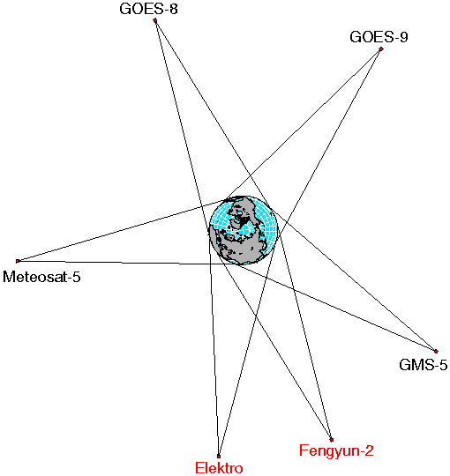
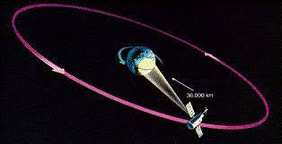
Geostationary Satellite
Advantages:
  In fixed position, can have permanent link with a transmitting ground station.
  A number of satellites with overlapping areas can maintain communication with any point on the Earth’s surface
Disadvantages
  As it is in equatorial orbits, communication in polar region is not possible
  As signal travels twice the distance between the satellite and Earth, there is a delay of 0.24 s. To reduce this problem geostationary satellites may be used in conjunction with optic fibres.

Slide 19
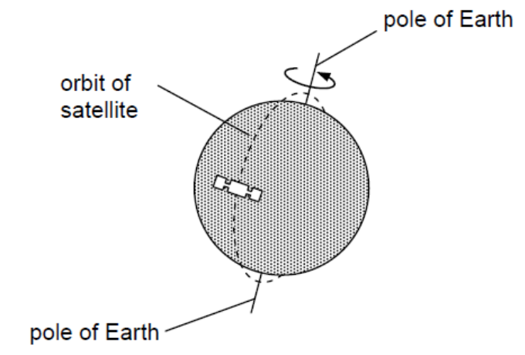
Polar Satellites
Polar satellites are satellites that have low orbits and pass over the poles.
Polar orbits have a period of rotation of the order of 90 minutes.
Such satellites will, as a result of the rotation of the Earth, at some time each day orbit above every point on the Earth’s surface.
Each orbit crosses the Equator 23° to the west of the previous orbit (due to the rotation of the Earth).

Slide 20
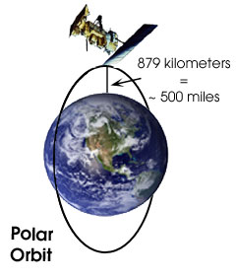
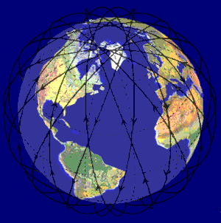
Polar Satellites
Disadvantage:
Continuous communication with a single polar satellite is not possible.
Ways to overcome:
Information may be transmitted to the satellite while it is overhead and the data stored and be transmitted back to Earth when it is over the appropriate area.
Continuous communication is possible using a number of polar satellites in orbits that are inclined to one another so that at least one satellite is always above the transmitter and receiver. In this case, the aerials must track the satellites in their orbits.

Slide 21
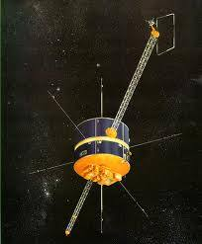
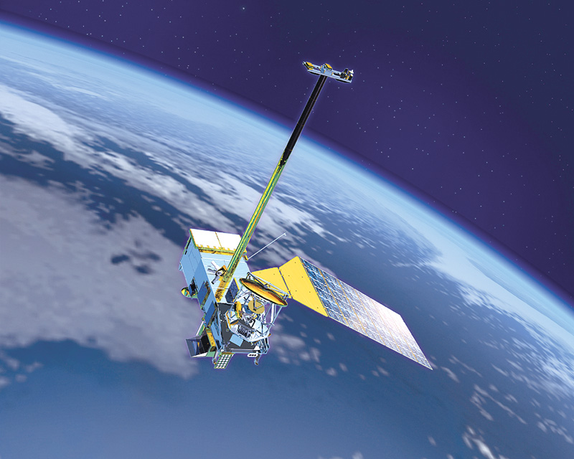
Polar Satellites
Advantage:
As their orbital height is only of the order of 10⁵ km (a few hundred kilometres) delays in the data transmission such as telephone conversations are not noticeable.
Uses:
Since polar satellites pass over the whole of the Earth in any 24-hour period, they are used for remote sensing such as military espionage, geological prospecting and weather forecasting.
The Global Positioning System (GPS) uses the signals from many of these satellites.

Slide 22
The Telephone System

Slide 23
The Early Telephone System
In the early days of telephones, each telephone user was connected to all other users by their own cables. This was feasible only where the number of users was small as in, for example, a single building.
As telephones became more popular and widespread, connections between individual users became impractical.
Consequently, the telephone exchange was developed.
  The caller would contact the telephone exchange and,
  at the exchange, the connection to the other user would be made by a person known as an ‘operator’.
If the call was not a local call served by that particular exchange, then the local exchange would contact the other user’s local exchange via a trunk exchange.
Trunk exchanges were connected via trunk lines and hence the expression ‘trunk call’ for any long-distance call.

Slide 24
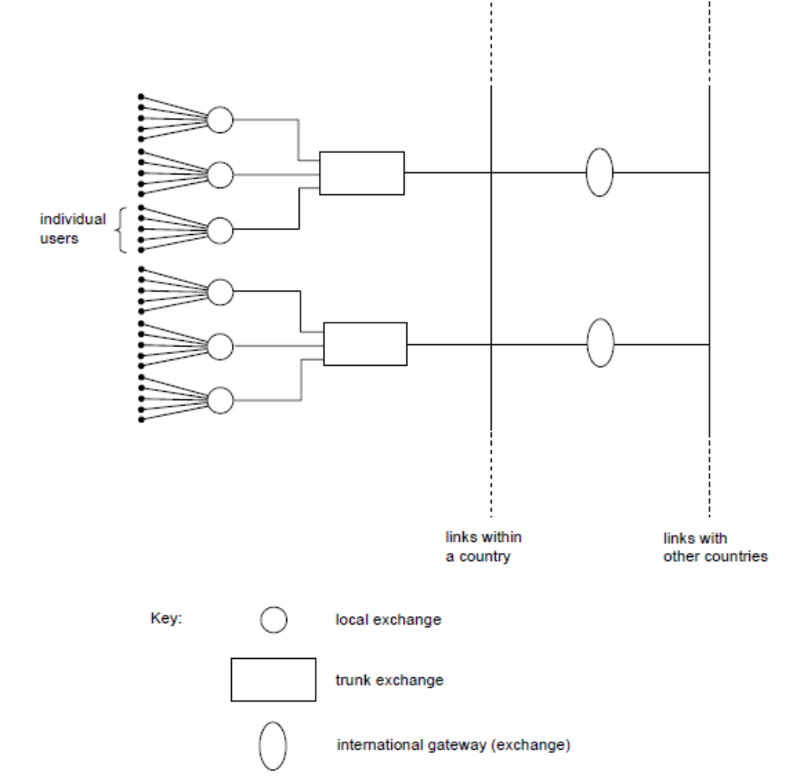
The Public Switched Telephone Network (PSTN)
In essence, the Public Switched Telephone Network (PSTN) uses the same principles of exchanges but has developed with modern technology and the number of users.
Switching is no longer done by operators but by automatic electronic relays.
International exchanges, called gateways, have been introduced so that telephone communication may be worldwide.

Slide 25
The Public Switched Telephone Network (PSTN)
The user is connected to the PSTN via the local exchange.
Each user has a ‘fixed line’ to the local exchange, resulting in the user having limited mobility whilst making the call.
Connections are made automatically by the electronic systems.

Slide 26
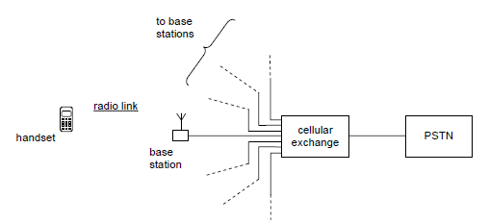
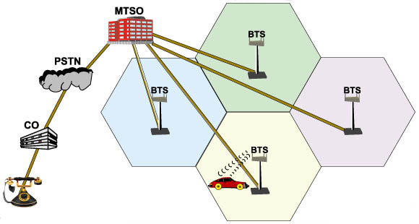
The Mobile Phone Systems
During the 1970s and 1980s, mobile phone systems were developed that did not have a permanent link to a local exchange.
Basically, a mobile phone is a handset that is a radio transmitter and receiver.
When a call is to be made, the user makes a radio-wave link with a nearby base station.
This base station is connected by cable to a cellular exchange. The cellular exchange then allows connection to be made to the PSTN.

Slide 27
The Mobile Phone Systems
The range of carrier-wave frequencies for linking between the mobile phone and the base station is limited. Each mobile phone cannot have its own carrier frequency, the same carrier frequencies must be used by many mobile phones at the same time. This is achieved using a network of base stations.
The base stations operate on UHF frequencies so that they have a limited range and are low-power transmitters.
The UHF frequencies also mean that the aerial in the mobile phone is conveniently short!
A country is divided into areas or cells, with each cell having its own base station, usually located near the centre of the cell.
The aerial at the base station transmits in all directions so as to cover the whole cell, but not to overlap too far into neighbouring cells. In this way, the whole country is ‘covered’.
Neighbouring cells cannot use the same carrier frequencies, otherwise interference would occur at the boundaries between cells.

Slide 28
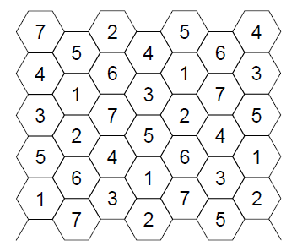
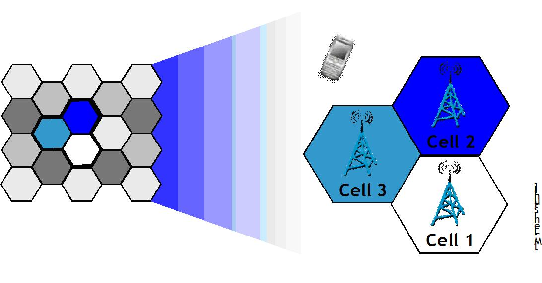
The Cell Phone
Although each cell is approximately circular (depending on the flatness of the land), the cells are shown as a ‘honeycomb’ so that the cells fit together.
The number in each cell represents a particular range of carrier frequencies that would be allocated to each cell.
Neighbouring cells do not have the same range of carrier frequencies.

Slide 29
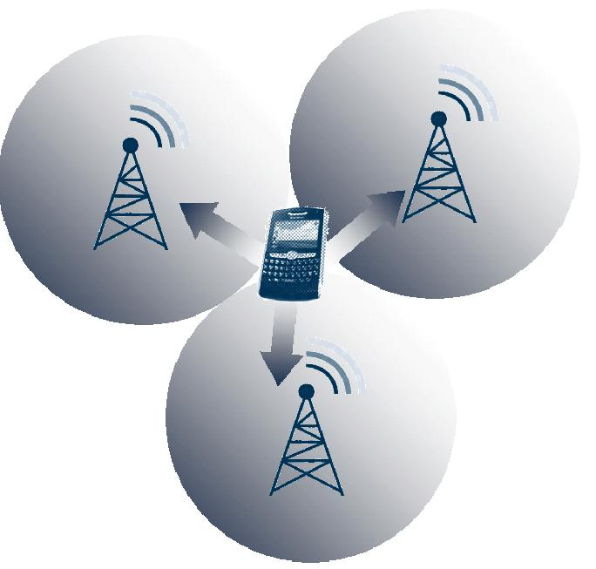
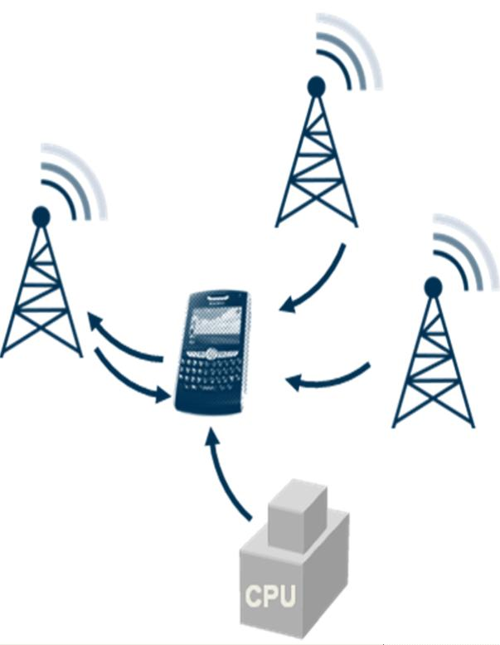
The Cell Phone
When a handset is switched on, it transmits a signal to identify itself.
This signal is received by a number of base stations, from where it is transferred to the cellular exchange.
A computer at the cellular exchange selects the base station with the strongest signal from the handset.
The computer also allocates a carrier frequency for communication between the base station and the handset.
During communication between the handset and the base station, the computer at the cellular exchange monitors the signal from the handset.
If the user of the handset moves from one cell to another, the signal strength changes. The call from the handset is then re-routed through the base station with the greater signal.

Slide 30
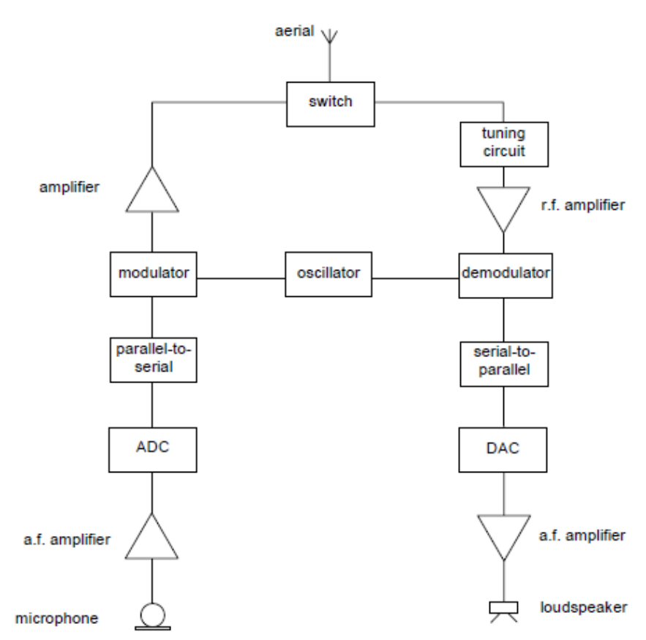
Making A Call
The caller speaks into the microphone.
This produces a varying signal voltage that is amplified and converted to a digital signal by means of the ADC.
The parallel-to-series converter takes the whole of each digital sample voltage and then emits it as a series of bits.
The series of bits is then used to modulate the chosen carrier wave.
After further amplification, the modulated carrier wave is switched to the aerial where it is transmitted as a radio wave.

Slide 31
Receiving A Call
On receipt of a signal at the aerial, the signal is switched to a tuning circuit that selects only the carrier-wave frequency allocated to it by the computer located at the cellular exchange.
This selected signal is then amplified and demodulated so that the information signal is separated from the carrier wave.
This information signal is in digital form. It is processed in a series-to-parallel converter to produce each sample digital voltage and then in a digital-to-analogue converter (DAC) to provide the analogue signal.
After amplification, the analogue signal is passed to a loudspeaker.

Slide 32
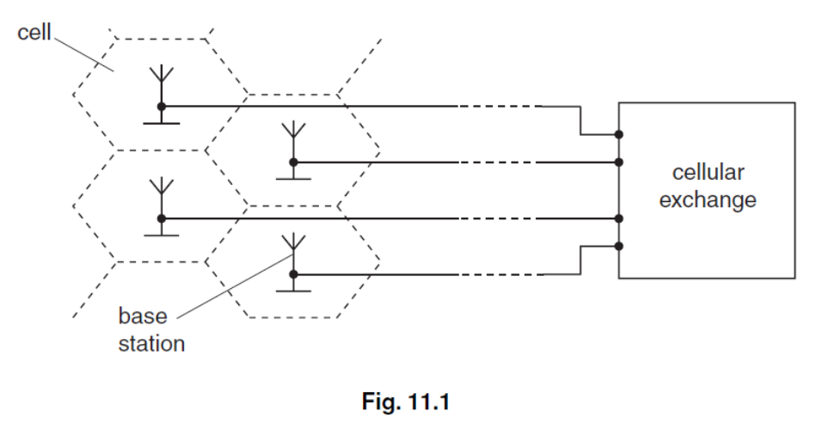
Cell Phone: Nov 2007 Q11
In a cellular phone network, a country is divided into a number of cells, each with its own base station.
Fig. 11.1 shows a number of these base stations and their connection to a cellular exchange.
(a) Suggest and explain why the country is divided into a number of cells. [2]
(b) Outline what happens at the base station and the cellular exchange when a mobile phone handset is switched on, before a call is made. [4]

Slide 33
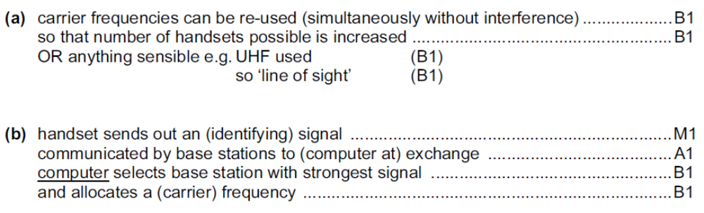
Solution: Nov 2007 Q11

Slide 34
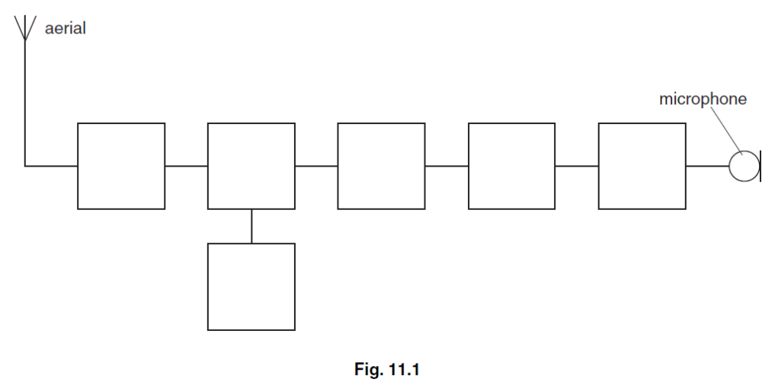
Cell Phone: May 2007 Q11
(a) Fig. 11.1 is a block diagram showing part of a mobile phone handset used for sending a signal to a base station.
Complete Fig. 11.1 by labelling each of the blocks. [3]
(b) Whilst making a call using a mobile phone fitted into a car, a motorist moves through several different cells. Explain how reception of signals to and from the mobile phone is maintained. [4]

Slide 35
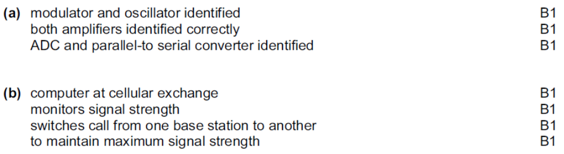
Solution: May 2007 Q11

Slide 36
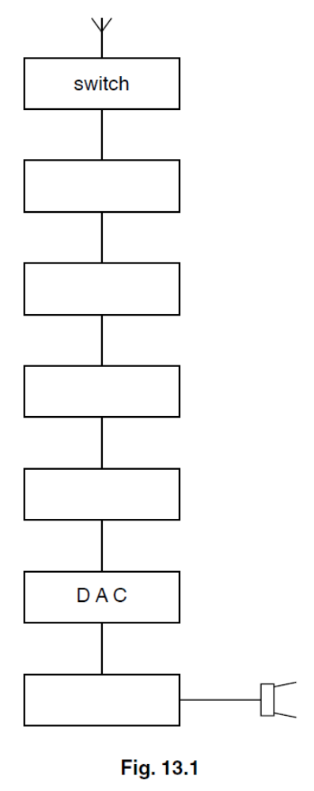
Cell Phone: May 2009 Q13
(a) Fig. 13.1 is a block diagram illustrating part of a mobile phone handset used for receiving a signal from a base station.
Complete Fig. 13.1 by labelling each of the blocks. [4]
(b) Explain the role of the base station and the cellular exchange when a mobile phone is switched on and before a call is made or received. [4]

Slide 37
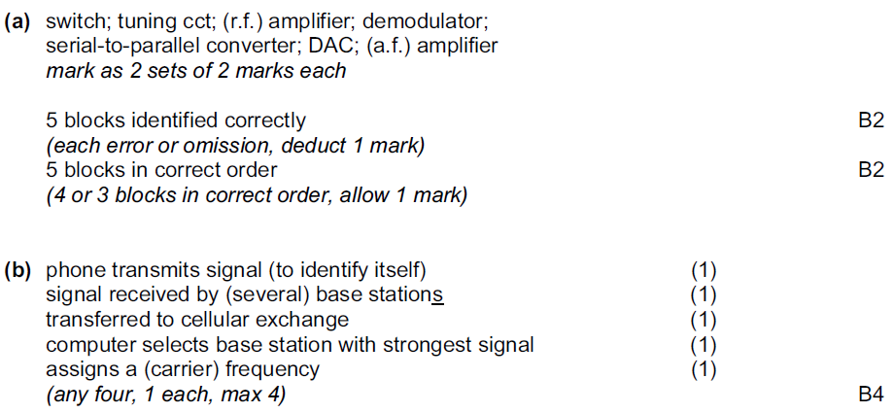
Solution: May 2009 Q13

Slide 38
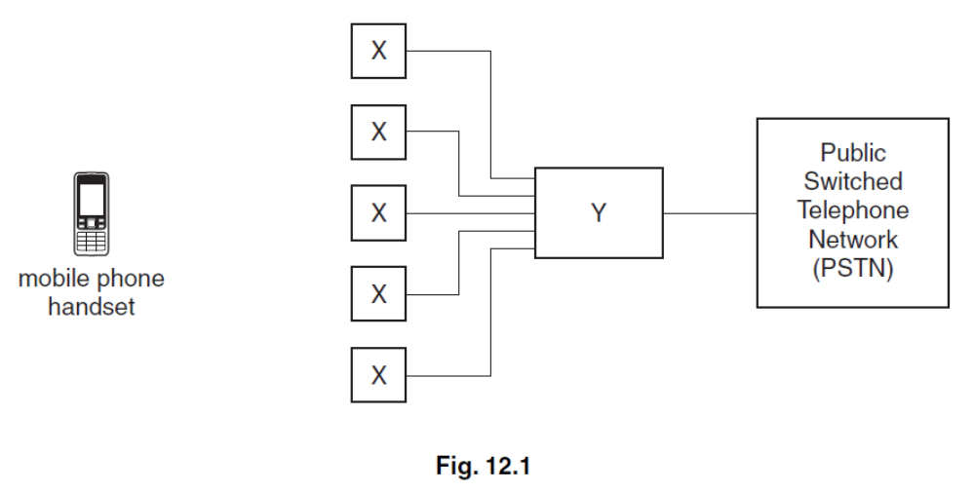
Cell Phone: Nov 2009 Q12
A block diagram representing part of a mobile phone network is shown in Fig. 12.1.
(a) State what is represented by
(i) the blocks labelled X, [1]
(ii) the block labelled Y. [1]
(b) A user of a mobile phone is making a call.
Explain the role of the components in the boxes labelled X and Y during the call. [5]

Slide 39
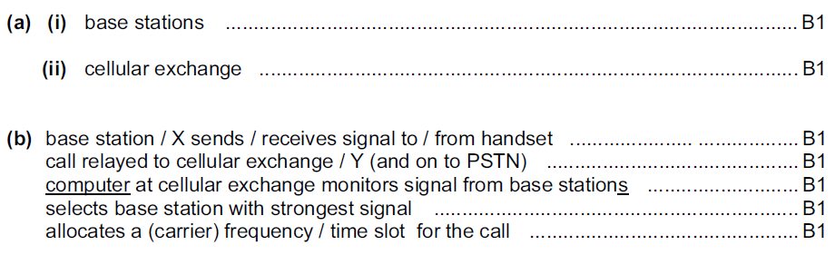
Solution: Nov 2009 Q12

Slide 40
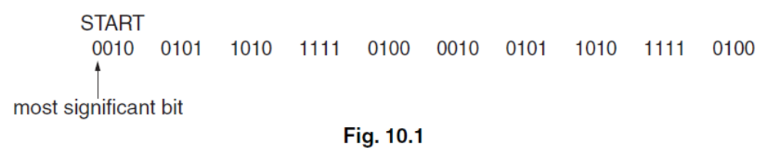
Digital: May 2007 Q10
An analogue signal is sampled at a frequency of 5.0 kHz. Each sample is converted into a four-bit number and transmitted as a digital signal.
Fig. 10.1 shows part of the digital signal.
The digital signal is transmitted and is finally converted into an analogue signal.
(a) On the axes of Fig. 10.2, sketch a graph to show the variation with time t of this final analogue signal. [4]
(b) Suggest two ways in which the reproduction of the original analogue signal could be improved. [2]

Slide 41
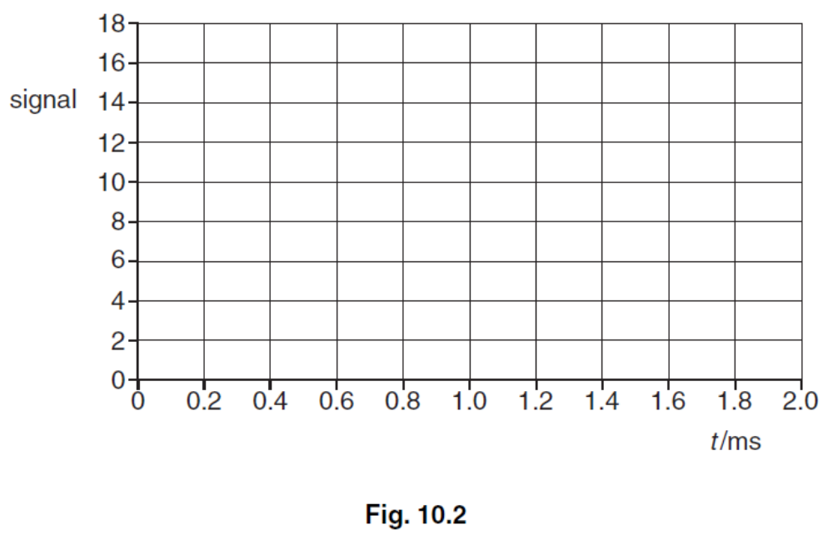
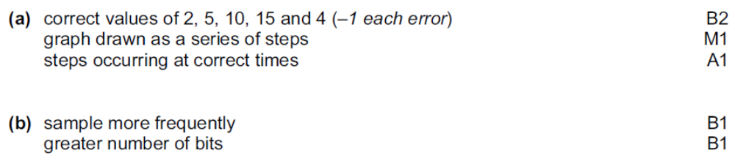
Solution: May 2007 Q10

Slide 42
Modulation: May 2008 Q11
(a) (i) Describe what is meant by frequency modulation. [2]
(ii) A sinusoidal carrier wave has frequency 500 kHz and amplitude 6.0 V. It is to be frequency modulated by a sinusoidal wave of frequency 8 kHz and amplitude 1.5 V.
The frequency deviation of the carrier wave is 20 kHz V^{–1}.
Describe, for the carrier wave, the variation (if any) of
1. the amplitude, [1]
2. the frequency. [3]
(b) State two reasons why the cost of FM broadcasting to a particular area is greater than that of AM broadcasting. [2]

Slide 43
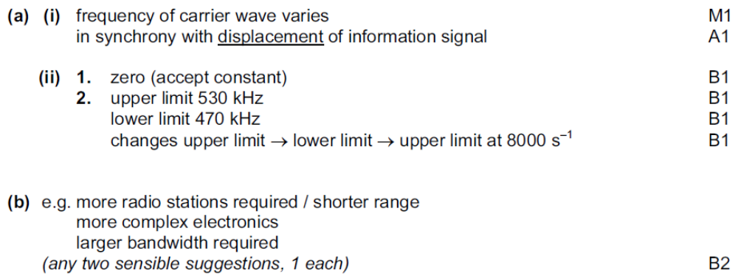
Solution: May 2008 Q11

Slide 44
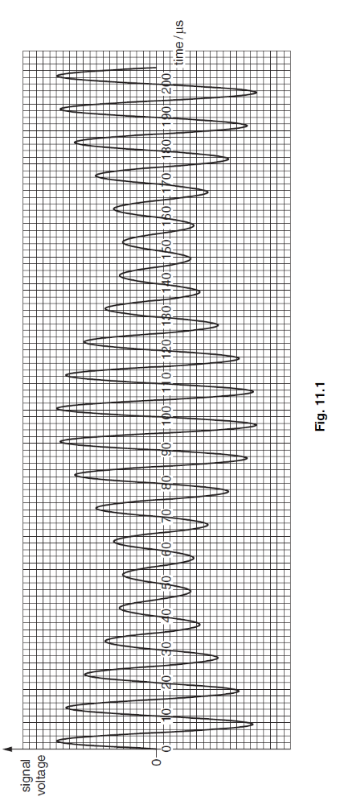
Modulation: Nov 2009 Q11
The variation with time of the signal transmitted from an aerial is shown in Fig. 11.1.
(a) State the name of this type of modulated transmission. [1]
(b) Use Fig. 11.1 to determine the frequency of
(i) the carrier wave, [2]
(ii) the information signal. [1]
(c) (i) On the axes of Fig. 11.2, draw the frequency spectrum (the variation with frequency of the signal voltage) of the signal from the aerial. Mark relevant values on the frequency axis.
(ii) Determine the bandwidth of the signal. [1]

Slide 45
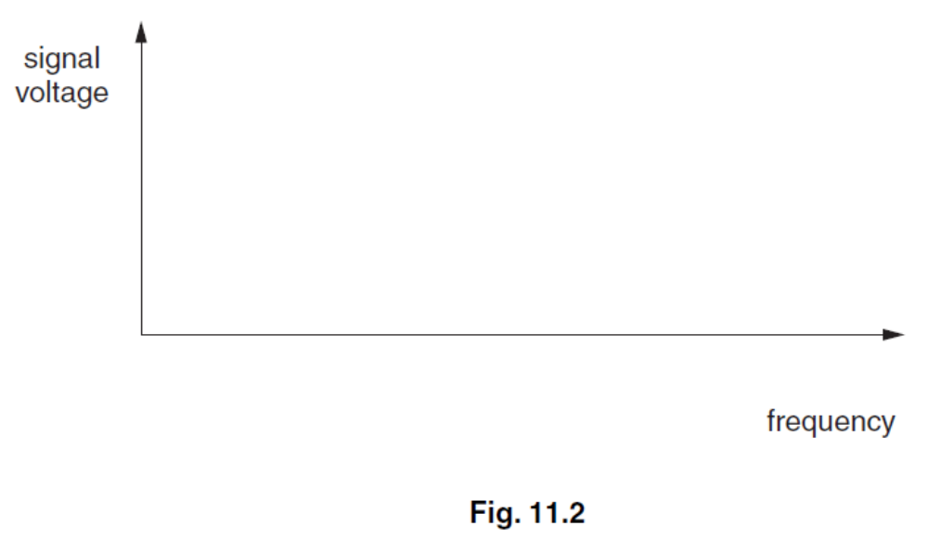
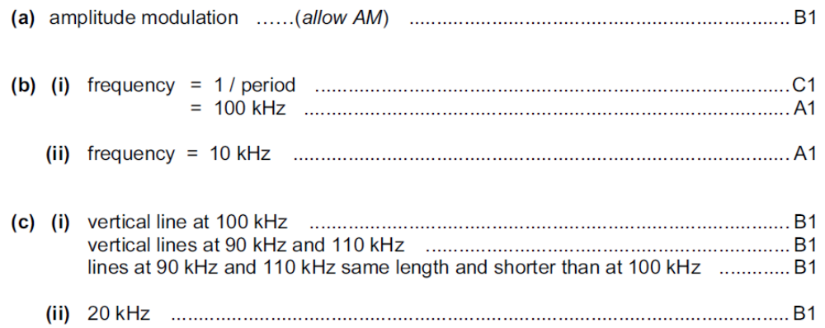
Solution: Nov 2009 Q11

